Slide 1

The Principle of Inclusion & Exclusion
+ or -?

Slide 2
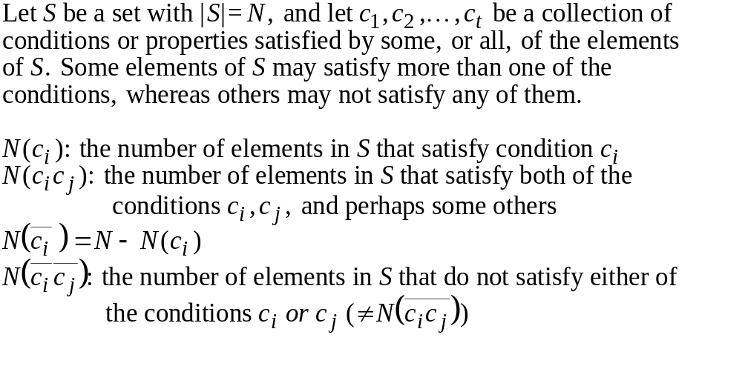
8.1 The Principle of Inclusion and Exclusion
不滿足c_{i}且不滿足c_{j}
不滿足c_{i}或不滿足c_{j}

Slide 3
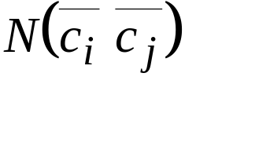
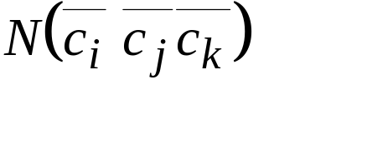







8.1 The Principle of Inclusion and Exclusion
=N-[
₊
]
+

Slide 4
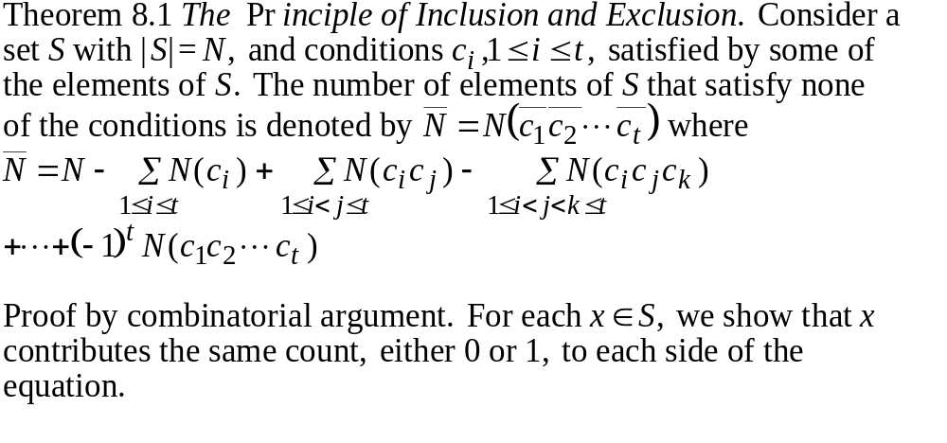
8.1 The Principle of Inclusion and Exclusion

Slide 5
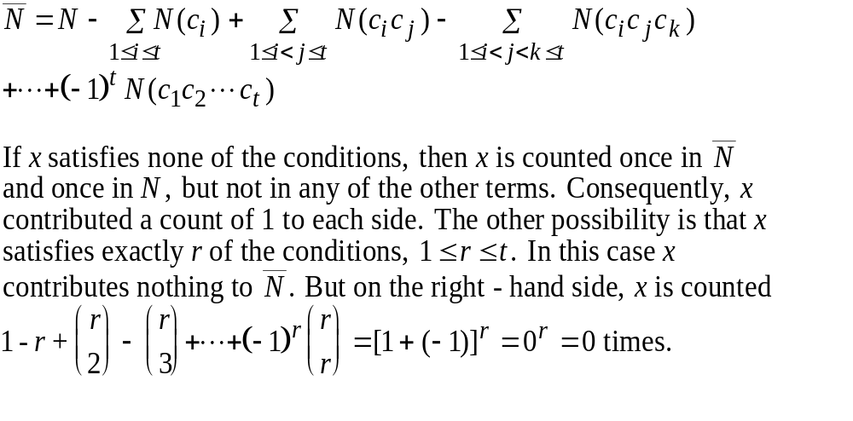
8.1 The Principle of Inclusion and Exclusion
Theorem 8.1 The Principle of Inclusion and Exclusion

Slide 6
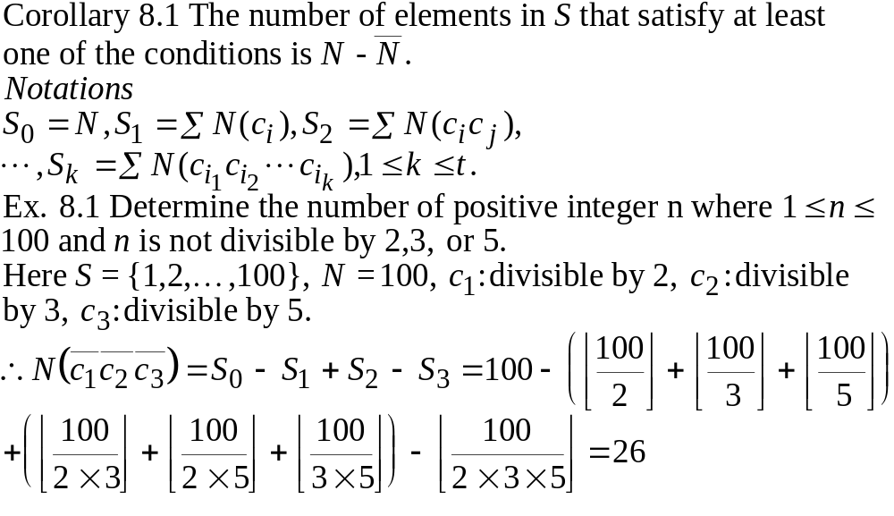
8.1 The Principle of Inclusion and Exclusion

Slide 7
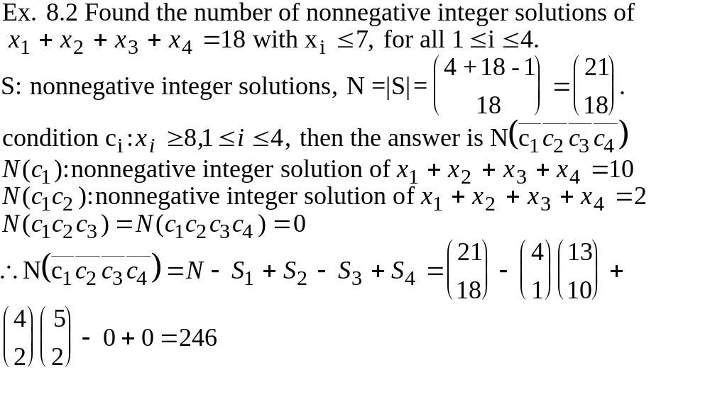
8.1 The Principle of Inclusion and Exclusion

Slide 8
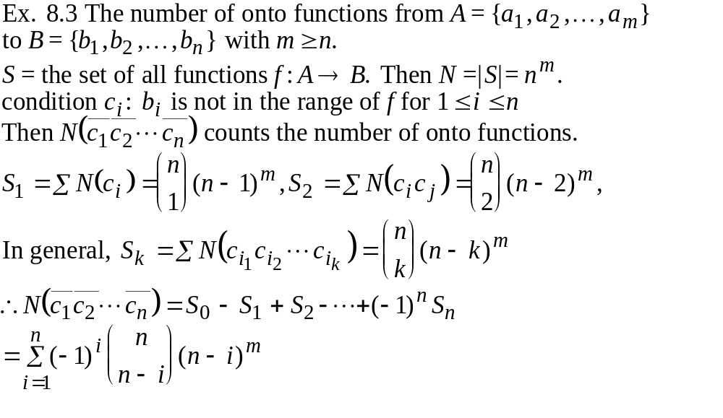
8.1 The Principle of Inclusion and Exclusion

Slide 9
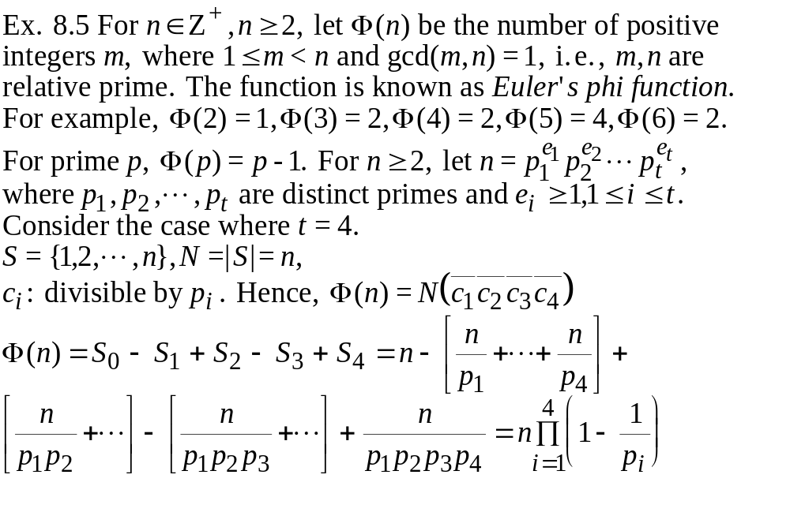
8.1 The Principle of Inclusion and Exclusion

Slide 10
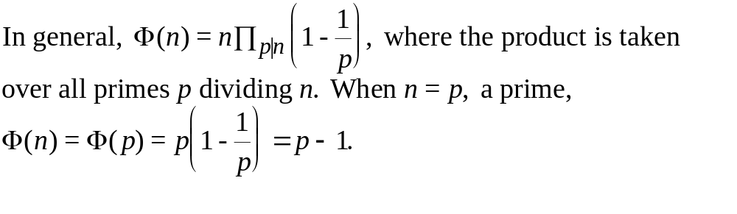
8.1 The Principle of Inclusion and Exclusion
Ex. 8.6 Construct roads for 5 villages such that no village will be
isolated. In how many ways can we do this?
O.K.
not O.K.

Slide 11
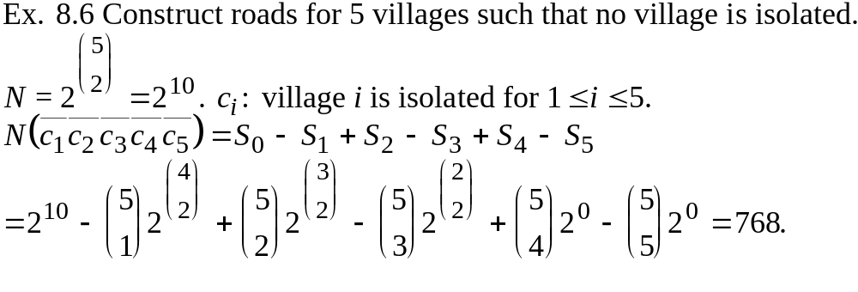
8.1 The Principle of Inclusion and Exclusion

Slide 12
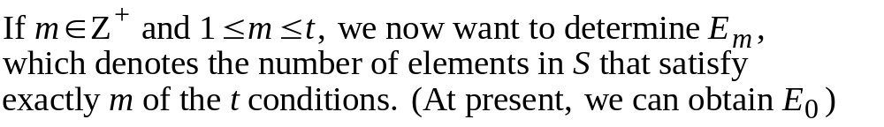
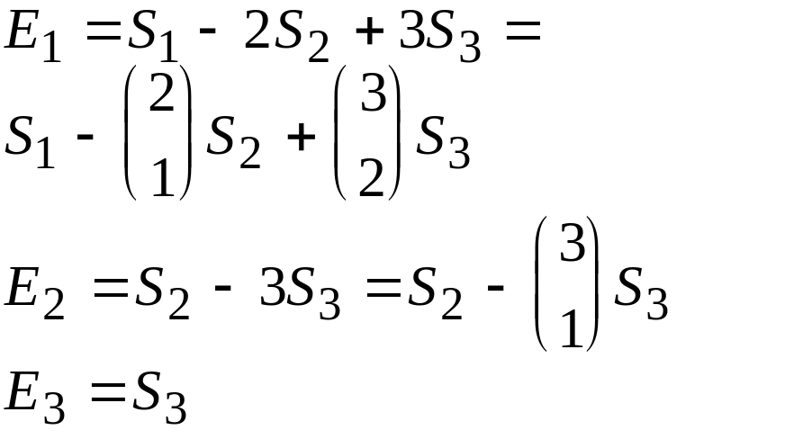
8.2 Generalizations of the Principle
c₁
E₁: regions 2,3,4
E₂: regions 5,6,7
1
2
6
5
8
7
4
3
c₃
c₂

Slide 13
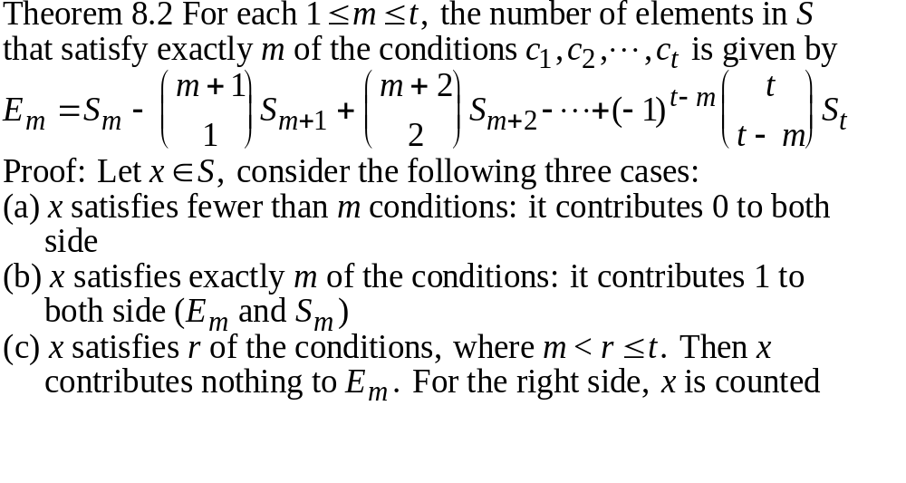
8.2 Generalizations of the Principle

Slide 14
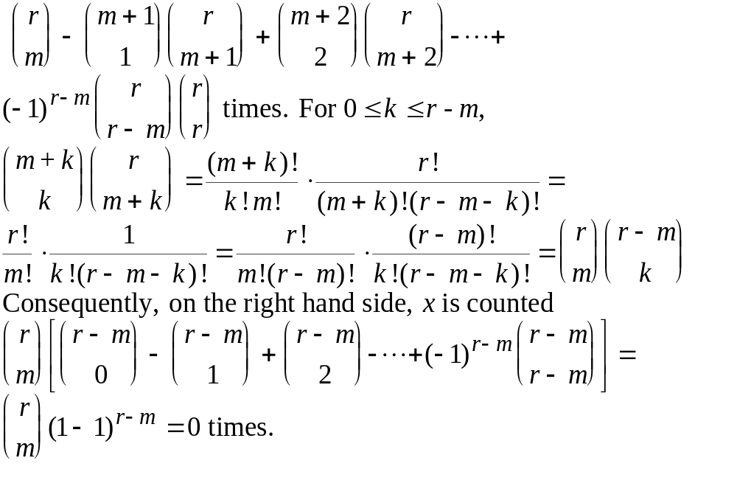
8.2 Generalizations of the Principle

Slide 15
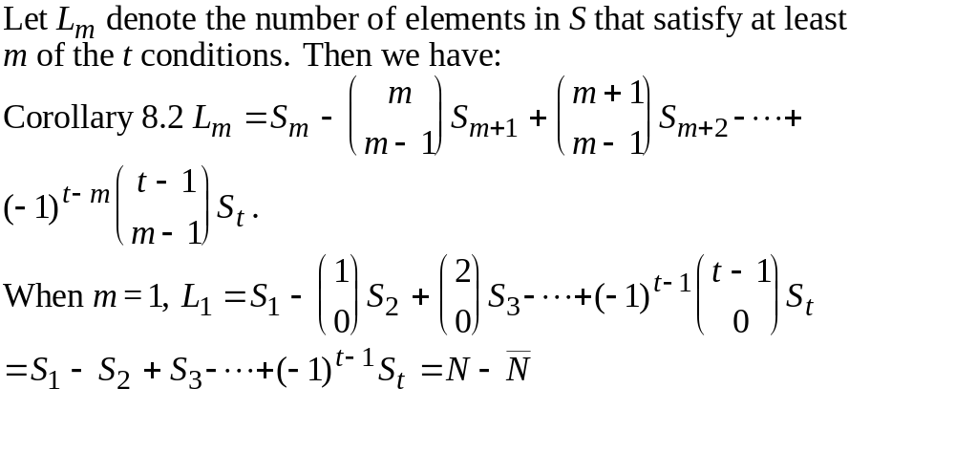
8.2 Generalizations of the Principle

Slide 16
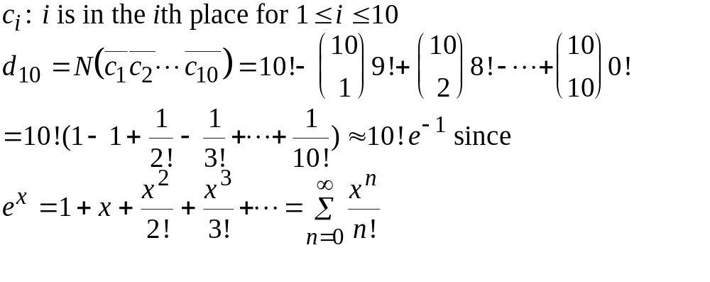
8.3 Derangements: Nothing Is in Its Right Place
Ex. 8.8 Find the number of permutations such that 1 is not in
the first place, 2 is not in the second place, ..., and 10 is not in
the tenth place. (derangements of 1,2,3,...,10)

Slide 17
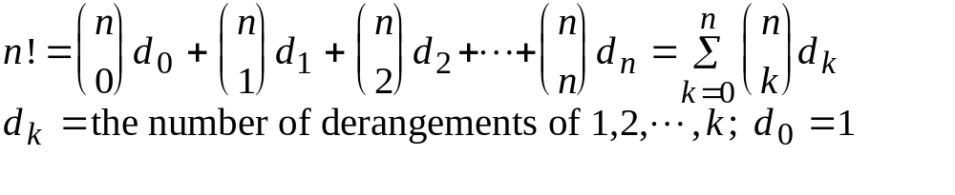
8.3 Derangements: Nothing Is in Its Right Place
Ex. 8.10 Assign 7 books to 7 reviewers two times such that
everyone gets a different book the second times.
Ans: first time 7!, second time d₇
therefore, 7! d₇

